Slide 1
Object-Oriented Programming
An example in kotlin
And the comparison to go

Slide 2
Contents
Structure and paradigms of OOP
„CherryBanks“ – A Kotlin project
Implementaion of OOP paradigms in Kotlin project
Comparison to Go
16.01.2023
Tobias Kirschner | Master Informatik | TH Rosenheim

Slide 3
Structure of OOP
Classes
Objects
Attributes
Methods
16.01.2023
Tobias Kirschner | Master Informatik | TH Rosenheim

Slide 4
Paradigms of OOP
Abstraction
Inheritance
Encapsulation
Polymorphism
16.01.2023
Tobias Kirschner | Master Informatik | TH Rosenheim

Slide 5
„CherryBanks“ – A Kotlin Project
Bank account system
Adding and deleting customers to/from bank
Choosing customers and adding/deleting bank accounts
Deposit and withdraw amounts to/from accounts
Data collected from console input
Actions displayed on console output
16.01.2023
Tobias Kirschner | Master Informatik | TH Rosenheim

Slide 6
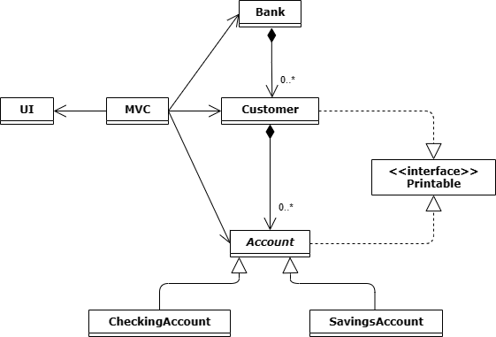
Programm Structure
16.01.2023
Tobias Kirschner | Master Informatik | TH Rosenheim

Slide 7





Programm Structure
16.01.2023
Tobias Kirschner | Master Informatik | TH Rosenheim

Slide 8


Programm Structure
16.01.2023
Tobias Kirschner | Master Informatik | TH Rosenheim

Slide 9


Programm Structure
16.01.2023
Tobias Kirschner | Master Informatik | TH Rosenheim

Slide 10
Abstraction
Exposing only necessary information to the user
Specifies what subclasses must be able to do
Does not necessarily prescribe how methods must be implemented
16.01.2023
Tobias Kirschner | Master Informatik | TH Rosenheim

Slide 11
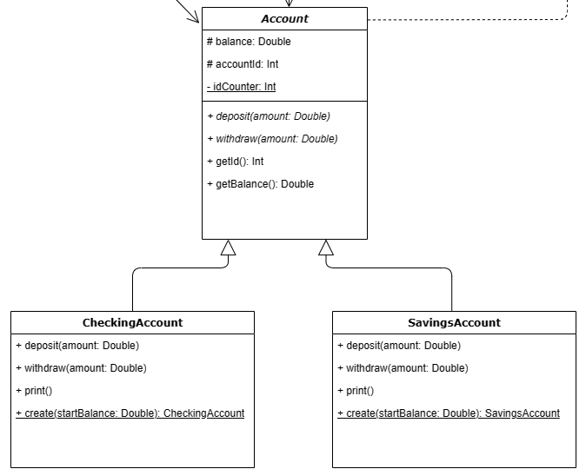
Abstraction
16.01.2023
Tobias Kirschner | Master Informatik | TH Rosenheim

Slide 12
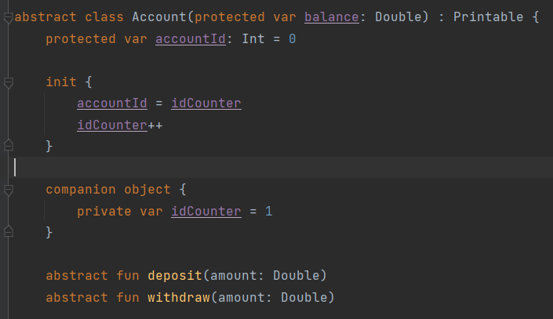
Abstraction
16.01.2023
Tobias Kirschner | Master Informatik | TH Rosenheim

Slide 13
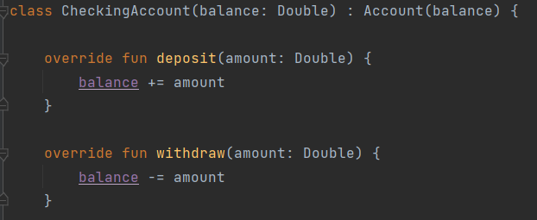
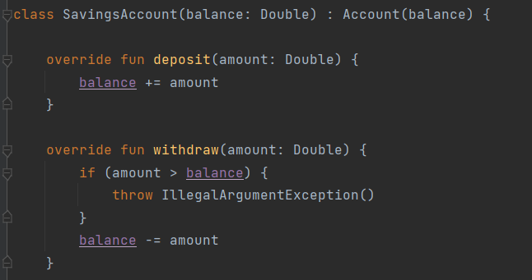

Abstraction
class Customer:
16.01.2023
Tobias Kirschner | Master Informatik | TH Rosenheim

Slide 14
Abstraction in Go
No concept of abstract classes or methods
No subclassing
Solution: Interfaces
Set of methods that a type must implement
16.01.2023
Tobias Kirschner | Master Informatik | TH Rosenheim

Slide 15
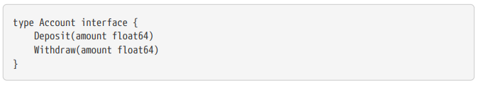
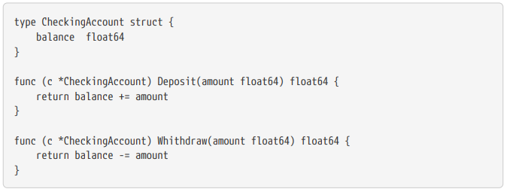
Abstraction in Go
16.01.2023
Tobias Kirschner | Master Informatik | TH Rosenheim

Slide 16
Inheritance
Inheritance of properties and behaviors from another class
Createing modified version of existing class
Superclass, Subclass
16.01.2023
Tobias Kirschner | Master Informatik | TH Rosenheim

Slide 17
Inheritance
Superclass
Subclass
Subclass
16.01.2023
Tobias Kirschner | Master Informatik | TH Rosenheim

Slide 18
Inheritance
Superclass
Subclass
Subclass
16.01.2023
Tobias Kirschner | Master Informatik | TH Rosenheim

Slide 19
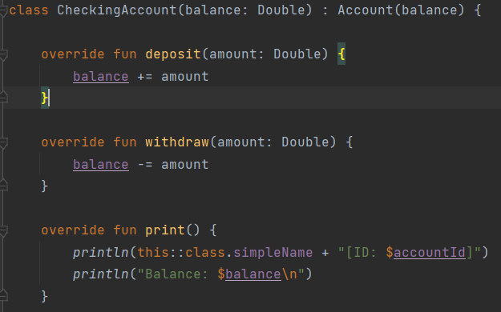
Inheritance
16.01.2023
Tobias Kirschner | Master Informatik | TH Rosenheim

Slide 20
Inheritance in Go
No inheritance
No keyword for classes/superclasses/subclasses
Solution: Type embedding
16.01.2023
Tobias Kirschner | Master Informatik | TH Rosenheim

Slide 21
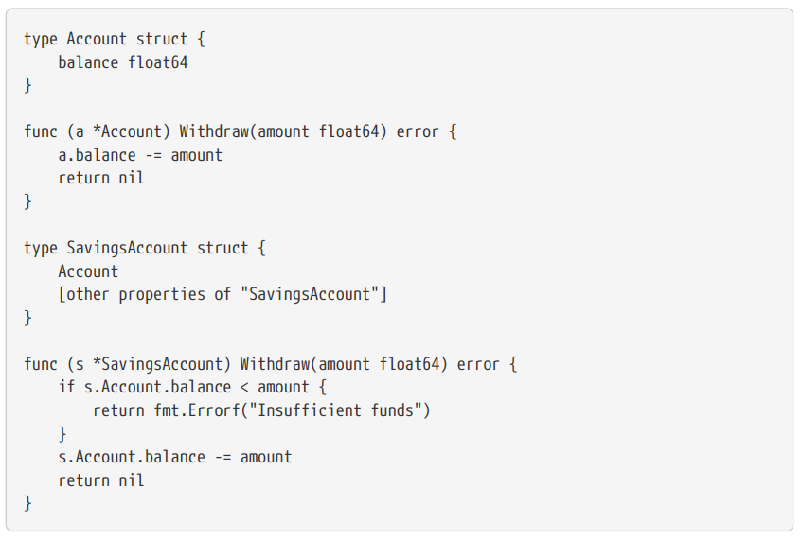
Inheritance
16.01.2023
Tobias Kirschner | Master Informatik | TH Rosenheim

Slide 22
Encapsulation
Bundling of data
Hiding a classes internal impementation details
Prevents other classes/code from direct access to the data
Promotes modularity
Makes it easier to maintain and modify code
16.01.2023
Tobias Kirschner | Master Informatik | TH Rosenheim

Slide 23
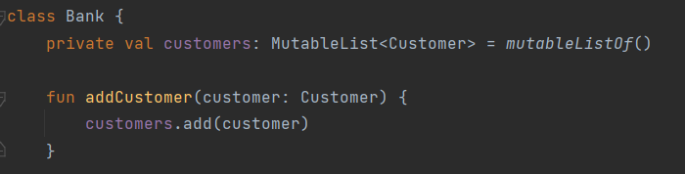
Encapsulation
16.01.2023
Tobias Kirschner | Master Informatik | TH Rosenheim

Slide 24
Encapsulation in Go
Achieved through capitalization of names
Capital letter: public (access from outside the package)
Lowercase letter: private (access only within package)
16.01.2023
Tobias Kirschner | Master Informatik | TH Rosenheim

Slide 25
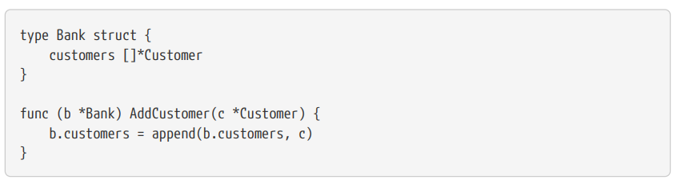
Encapsulation in Go
16.01.2023
Tobias Kirschner | Master Informatik | TH Rosenheim

Slide 26
Polymorphism
Different objects respond to the same method call in different ways
Objects can be treated uniformly despite different implementation
Flexible and extensible code design
16.01.2023
Tobias Kirschner | Master Informatik | TH Rosenheim

Slide 27


Polymorphism
16.01.2023
Tobias Kirschner | Master Informatik | TH Rosenheim

Slide 28

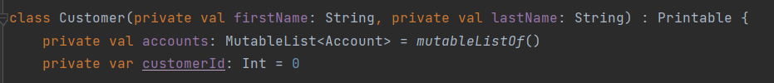
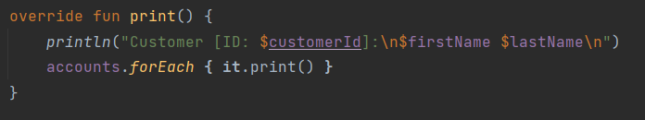
Encapsulation
16.01.2023
Tobias Kirschner | Master Informatik | TH Rosenheim

Slide 29
Polymorphism in Go
Also supported through interfaces
Set of methods type must implement (to implement Interface)
Sharing common set of behaviors among different types
16.01.2023
Tobias Kirschner | Master Informatik | TH Rosenheim

Slide 30
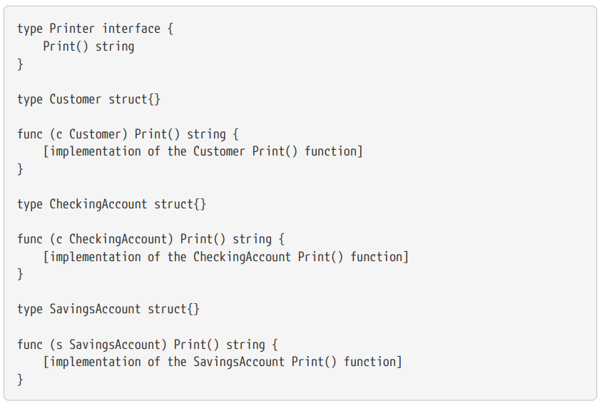
Polymorphism
16.01.2023
Tobias Kirschner | Master Informatik | TH Rosenheim

Slide 31
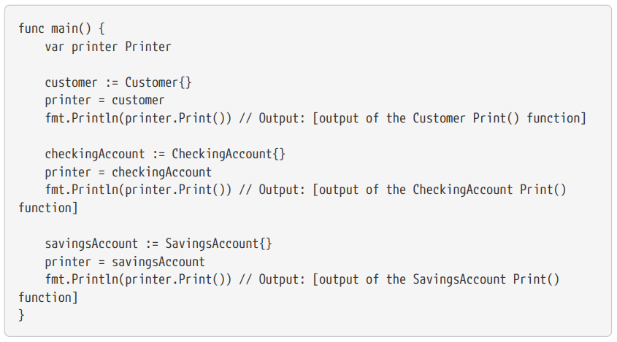
Polymorphism
16.01.2023
Tobias Kirschner | Master Informatik | TH Rosenheim

Slide 32
Conclusion
Kotlin supports all important principles of OOP
Go allows OOP with some detours
Banking system successfully implemented
Lessons learned
16.01.2023
Tobias Kirschner | Master Informatik | TH Rosenheim

Slide 33
Thank you!
Tobias Kirschner
Master Informatik
Th Rosenheim
16.01.2023

